Slide 1
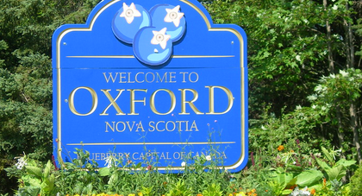
Town of Oxford
From Crisis to Confidence: How we used asset management to secure our infrastructure future
Ruthann Brookins
Manager of Finance
Notes:
When our residents think about infrastructure, most picture what’s right in front of them, the roads, the sidewalks and the buildings. But what we don’t see is just as important. This is the story of how Oxford, Nova Scotia, is facing hard truths about its infrastructure and using asset management to turn limited resources into a sustainable plan for the future.

Slide 2
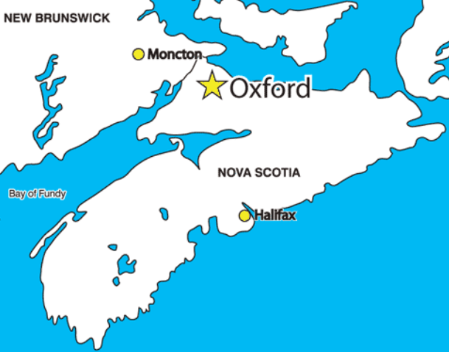
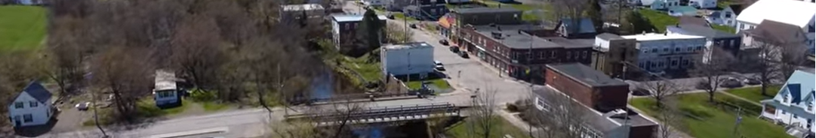
Town at a Crossroads
~1300 residents
Experiencing growth since 2021
30% population over 60 years old
Asset Management – not an overnight affair
  2019 / 2020 – MAMP – Inventory, mapping, level of service, risk assessments
  2021 / 2022 – MAMP – Capital plan and first asset management supported rate study
  2024 / 2025 – Updated capital plan and rate study
  2025 – Public engagement and funding strategies
Municipalities exist to provide services to a community
Notes:
Founded in the early 1790s by Richard Thompson, the town’s name has a charming origin: settlers used oxen to “ford” a shallow river, and the name Oxford stuck. It is at the junction of three rivers, River Philip, Little River and Black River that contribute to natural beauty, gave Oxford its early settlement appeal and can also test our roads, pipes and budgets.

Slide 3
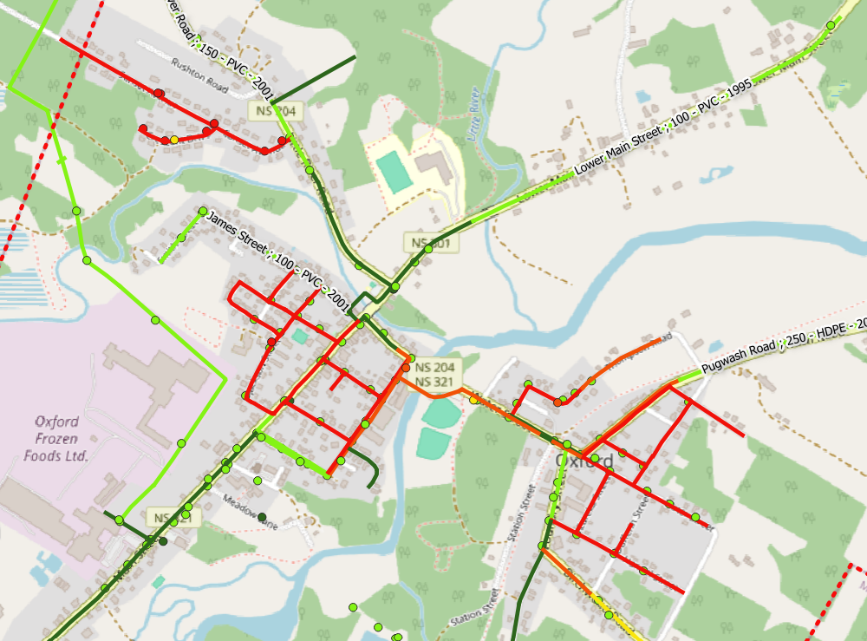
Key Issues
$136M in assets
Full suite of municipal services
Aging water system (1930s – 1970s)
25% poor or very poor condition
Original reservoir past end of life (SAR)
Inflation outpacing road investment
Main Street in poor condition
Insufficient funding for renewal
Notes:
Note past practices like
“fixing it when it breaks”. Potholes? Pave it. Water break? Patch it. Roof leak? Repair it.
no consistent record of what was owned, where it was, etc.,
roads paved but torn up for water main breaks, focus on surface upgrades (paving) but no capital for underground infrastructure,
rates set based on historical cost, not future needs.

Slide 4
Risk Based Prioritization

Slide 5
Risk Based Prioritization
CONSEQUENCE | RANK | CULTURAL / POLITICAL | ECONOMIC | LEGAL | SAFETY | ENVIRONMENTAL | EQUITY | OPPORTUNITY COST / REWARD
INSIGNIFICANT | 1 | Public will not notice. No impact to cultural resources or groups. No impact to relations with other levels of government. | Costs are minor and expected within ongoing operational budget. | No regulatory or legal impacts. | No risk to safety above baseline conditions. | No impact to the environment. | Impacts to residents are experienced relatively equally | There is no potential lost opportunity
MINOR | 2 | Minor public notice, public contacts staff only - single point of contact. Municipality can alert the public prior to widespread social media activity. No impact to cultural resources or cultural groups. No impact to relations with other levels of government. | Unexpected operational cost can be accommodated by redistribution of yearly budget. Grant can offset the unexpected cost. | Failure may result in small claims. | Risk of "near miss" incidents, low risk of injury. | Short term effects to the environment requiring one time remediation of mitigation to restore the system to its original state. Notification to NSE. | Impacts disproportionally affect a specific economic or cultural group for the duration of the service disruption with respect to access to core services like water, transportation, recreation, etc. | Service disruption or delay in project results in a delay of planned economic development, deferred savings in operations costs.
MODERATE | 3 | Moderate public notice - multiple single points of contact, elected officials are contacted. Social media has a presence in terms of pictures or video. Coverage in local news, requires official municipal response. Impact to cultural groups limited. | Unexpected operational cost requires cancellation of minor planned activities accommodate. No long-term financial impacts. Minor impact to tourism. Grant cannot offset unexpected cost. | Failure may result in litigation and informal inquiry. | More unlikely than likely to cause short- or long-term injury, no risk of loss of life. | Short term effects to the environment requiring temporary remediation or mitigation which restore the system to its original state. Submit plans for approval to NSE. | Impacts disproportionally affect a specific economic or cultural group with respect to access to core services like water, transportation, recreation, etc. that continues in the year following the service disruption. | Service disruption or delay in project could result in a long-term delay of significant economic development opportunities or major operational savings that could be diverted to capital projects.
MAJOR | 4 | Potential for injury. Mayor / CAO is notified. Public notice is widespread, large volume of multiple contacts. Social media has a strong awareness in terms of pictures or video. Coverage in local news, requires official municipal response. Interruption of service greater than 1 day. Coverage in provincial news. Impact to cultural groups widespread. | Unexpected operational cost requires cancellation of major planned activities to accommodate. Long term financing required to accommodate. Loss of commercial or tourism service greater than 5 days. | Failure may result in class action litigation and formal inquiry. | More likely than not to cause short- or long-term injury, low potential for loss of life. | Long term effects to the environment requiring sustained remediation or mitigation. System may not ultimately reach its original state. NSE issues a directive to the Town. | There are medium-term (<10 years) effects limited to a specific economic or cultural group resulting in displacement / relocation, health impacts or financial loss. | Service disruption or delay in project could result in lost opportunity to realize significant economic development opportunities or major operational savings that could be diverted to capital projects.
CATASTROPHIC | 5 | Potential for loss of life. Road sinkhole / caving in. Coverage on the National. | Property damage that the Town is liable for. Loss commercial or tourism service greater than a season. Financing requirements may render the municipality insolvent. | Failure results in contravention of laws, significant litigation, court action and multiple litigations. | More likely than not to cause short- or long-term injury, potential for loss of life. | Permanent or long-term environmental effects that cannot be remediated or mitigated. Failure to comply results in legal action. | There are long-term (>20 years) effects limited to a specific economic or cultural group resulting in displacement / relocation, health impacts or financial strain. | Service failure results in inability to achieve strategic plan goals, resulting in a need to redefine the plan. Inability to complete project results in loss of significant (>80%) funding opportunity.

Slide 6
Risk Based Prioritization
Extreme Risk - immediate intervention. High likelihood of major or catastrophic impacts within the planning period, which is not acceptable at any time.
If the asset has failed (still providing the service, but not at expected service levels):
  Consequence = catastrophic, address in year 1 of the 5-year plan
  Consequence = major, address in year 1 or 2 of the 5-year plan
  Consequence = moderate, address in year 3 of the 5-year plan
  Consequence = minor, address in year 4 of the 5-year plan or defer
  Consequence = insignificant, address in year 5 of the 5-year plan or defer
High Risk - Fix in the 5-year program, where assets with shorter lifespans (fleet) are included earlier in the program, and those with longer lifespans (water mains) can be included later in the program.
Very Low to Medium Risk are forecast for replacement outside the 5-year plan based on:
a) when they are forecast to become high risk, or
b) at a percentage of anticipated life depending on consequence of failure, or
c) run to failure for low and very low consequences, unless funding is available

Slide 7
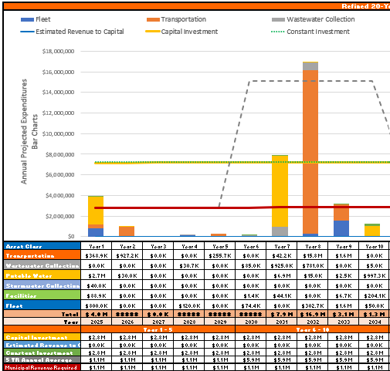
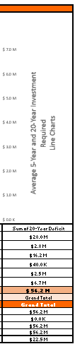
Choosing Asset Management – A Turning Point
Rate setting – look forward, not backward
Requested reserve funds for future work
Project go-ahead requires 50% funding from outside sources
Big picture thinking – road investment driven by critical underground assets
Level of Service focus – identify risks to services
Sustainable thinking – incorporate climate planning and leverage funding in financial plan
Asset management is a tool used in preparing capital budgets, UARB rate studies, transparency to audit committee and funding applications.
Notes:
Our first asset inventory was like turning on the lights in a dark room. We could see the exact age, projected condition, and replacement cost of every water main and every road section. That started the shift - critical underground assets first, roads after. No more paving over ticking time bombs. We also began thinking in decades, not just in budget cycles.
UARB allowed a line for capital expenditures.
Point out large demand on roads (orange) and water (yellow) in the next 10 years on chart.

Slide 8

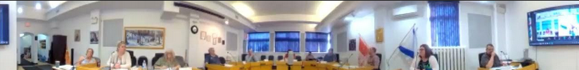
Working Toward Buy-In
Council Engagement
  Condition maps and future projections
  State of infrastructure and modern challenges
  Risks to services without action
  Reality of limited funding
Community Engagement
  Public session on infrastructure
  Input and dialogue with press
  Open and transparent
Notes:
This was a big change for council and the community. We had to explain why some roads might look rough for a few more years because the water lines beneath them needed replacement first.
It is a ‘dig once’ approach. Replace the buried infrastructure, then rebuild the road. That way, we only spend once, and we protect that investment for its full life
Discuss outcomes of council engagement, Mark’s feedback on presentation, community feedback

Slide 9
Key Takeaways
Consider all assets together in planning
Municipal revenue is insufficient for large projects – rely on creative outside funding
Next major projects: Main Street and Pugwash Road (water system)
Priority is replacing water system from the 1930s, align road replacements
Public engagement: educate on issues and emphasize this is not “an Oxford issue.”
Prioritize upgrades for water and wastewater regulatory compliance
Consider feasibility of investment in big ticket facilities (arena) or adding new infrastructure
Well though out planning can avoid further increases in spending and defer projects to make up infrastructure gap.
Notes:
This is what was presented to council and the public for feedback

Slide 10
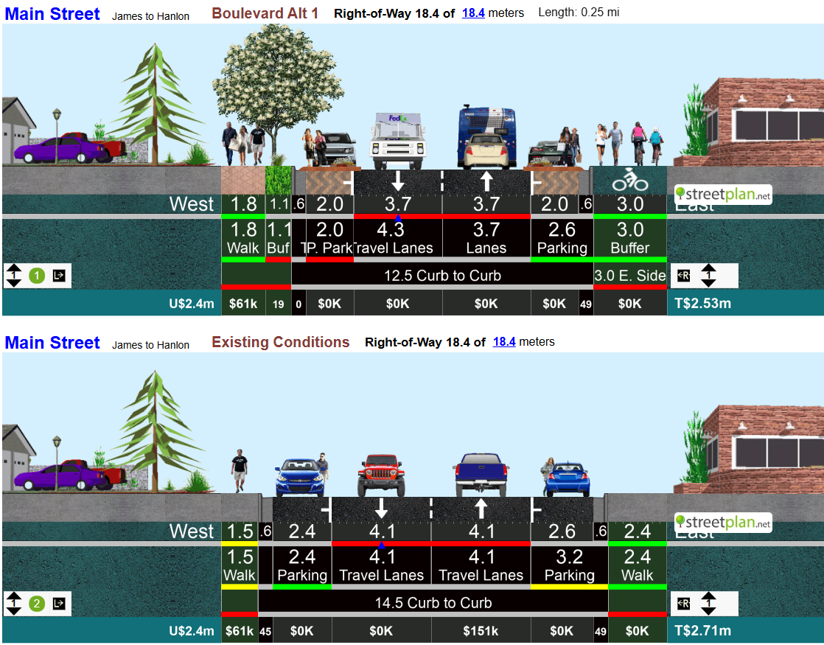
Strategic Project Design
Community Demand: Replace Main Street Asphalt
Used the Climate Ready Infrastructure Service to make it resilient
Open new funding pathways (LLCA), modern design
Proposed Design
Use natural solutions (rain gardens)
3690m² asphalt, 7.2m wide, 2 lanes plus permeable pavers for parking
Accessible active transportation
Climate resilient storm system
$4.4M
Existing condition
5200m2 asphalt, 14m wide, 2 lanes plus parking both sides
Regulatory issues
No funding
$4.3M
Notes:
Discuss leveraging supports, HICC CRIS program, AIM Network, local consultants

Slide 11
Closing Thoughts
You can’t do everything all at once
Services will age faster than the ability to replace them
What are critical services – prioritize what you can’t lose
New infrastructure: cost to operate and replace
Managing infrastructure = managing finances (tax and rates)
Water rates are likely to go up in municipalities across Canada
We are all in this together!
Notes:
Use HRM as a case study for rates (operational deficit, critical failures in storm & water systems, 16% then 17%), Oxford is lower than surrounding areas. Tatamagouche, average quarterly is 246$, Oxford new rates are $111 quarterly. Cumberland $156, needs to increase
Today, Oxford’s infrastructure approach is coordinated, and a plan for stable reserves to meet our 20-year needs. It’s not perfect but it’s more predictable than it ever was, and that’s the difference. We’ve moved from reacting to planning. Asset management isn’t just about spreadsheets; it’s about giving your community a stable, sustainable future.

Slide 12


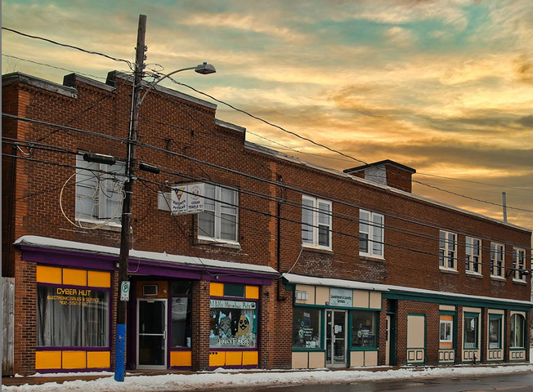
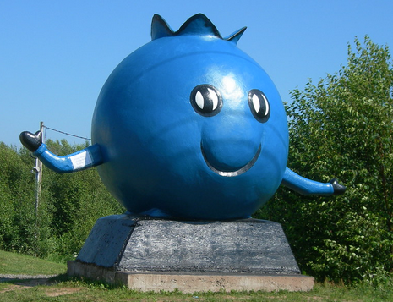
Questions and Discussion

